Slide 1

ECE201R01 : Microprocessor & Microcontroller
Unit I: 8086 Microprocessor Architecture
8086 - Architecture
Notes:
This is the introduction of microprocessor

Slide 2
Specifications of μP
Instruction Set: It is the set of instructions that the microprocessor can understand
Instruction length: Number of bits used to represent a single instruction
Clock Speed: Determines the number of operations per second the processor can perform.
  Expressed in MHz or GHz
  It is also known as Clock Rate
Word Length: Depends upon the width of ALU
  Internal data bus, registers, etc. may follow word length
  An 8-bit microprocessor can process 8-bit data at a time
  The word length ranges from 4 bits to 64 bits
8086 - Architecture

Slide 3
Definition of
Microprocessor & Microcontroller
Microprocessor
  is a multipurpose, programmable device that accepts digital data as input, processes it according to instructions stored in its memory, and provides results as output
  (or)
  is a multipurpose, programmable, clock-driven, register-based electronic device that reads binary instructions from a storage device called memory accepts binary data as input and processes data according to instructions, and provides result as output
Microcontroller
  is a small computer on a single integrated circuit containing a processor core, memory, and programmable input/output peripherals
  (or)
  CPUs with integrated memory or peripheral interfaces
Components of Microprocessor

Slide 4
8086 μP - Features
40 pin dual in-line package requires +5V power supply
16-bit Microprocessor
20 address lines - access up to 2²⁰ memory locations (1 M)
16 data lines
Support up to 64KB I/O address space
Supports two modes of operation
  Maximum mode is suitable for system having multiple processors
  Minimum mode is suitable for system having a single processor
Has an instruction queue, which is capable of storing six instruction bytes from the memory resulting in faster processing
01/08/25 10:39 AM
MPMC Unit - I
Notes:
1M * 1B = 1MB
01/08/25 10:39 AM

Slide 5

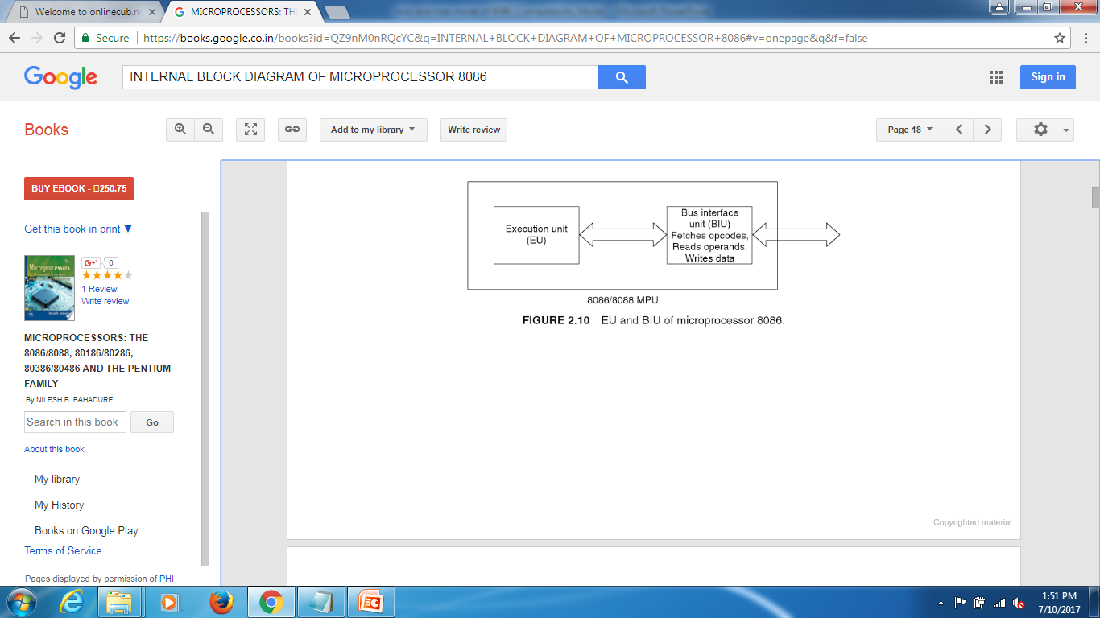
8086 - Architecture

Slide 6
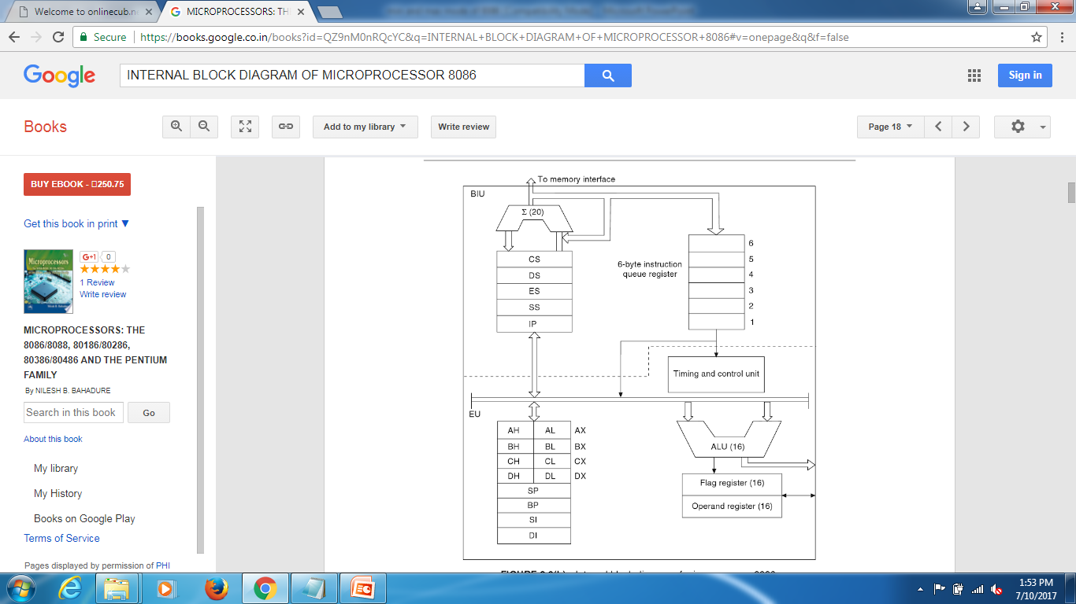
Architecture of - 8086
Bus Interfacing Unit (BIU)
The BIU performs all bus operations such as instruction fetching,
reading and writing operands for memory and calculating the
addresses of the memory operands.
The instruction bytes are transferred to the instruction queue.
Execution Unit (EU)
EU executes instructions from the instruction byte queue
8086 - Architecture

Slide 7
Architecture of - 8086
8086 - Architecture

Slide 8
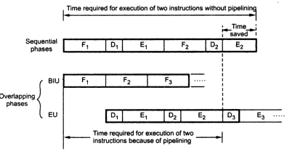
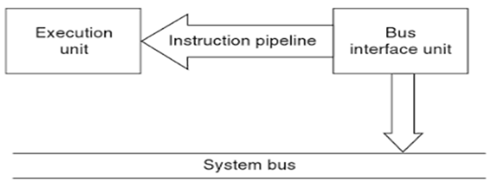
Pipelining in 8086
8086 - Architecture

Slide 9
Thank you . . .
8086 - Architecture

